Slide 1
Amplitude relations in Yang-Mills theory and Gravity
Amplitudes et périodes­ 3-7 December 2012
Niels Emil Jannik Bjerrum-Bohr
Niels Bohr International Academy,
Niels Bohr Institute

Slide 2
Introduction

Slide 3
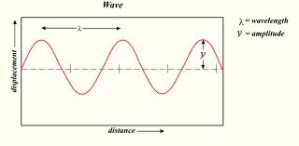
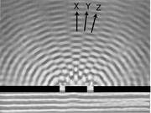
Amplitudes in Physics
Important concept: Classical and Quantum Mechanics
Amplitude square = probability

Slide 4
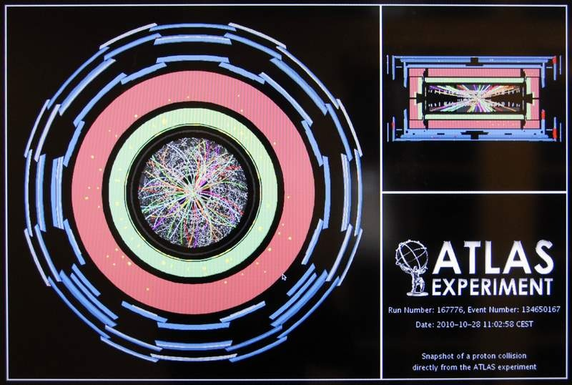
Large Hadron Collider
LHC ’event’
Proton
Jets
Jets:
Reconstruction complicated..
Calculations necessary:
Amplitude
…
Jets
Proton

Slide 5
How to compute amplitudes
Quantum mechanics:
Write down Hamiltonian
Field theory: write down Lagrangian (toy model):
Kinetic term Mass term Interaction term
E.g. QED Yukawa theory Klein-Gordon QCD Standard Model
Solution to Path integral -> Feynman diagrams!

Slide 6
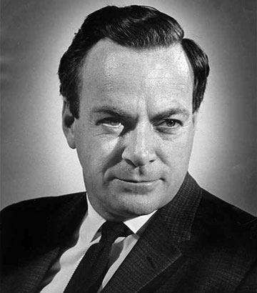
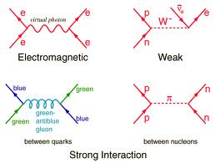
How to compute amplitudes
Method: Permutations over all possible outcomes (tree + loops (self-interactions))
Field theory: Lagrange-function
Feature: Vertex functions, Propagator (gauge fixing)

Slide 7
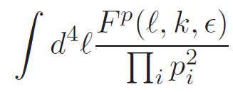



General 1-loop amplitudes
n-pt amplitude
p = 2n for gravity
p=n for YM
Vertices carry factors of loop momentum
Propagators
(Passarino-Veltman) reduction
Collapse of a propagator

Slide 8
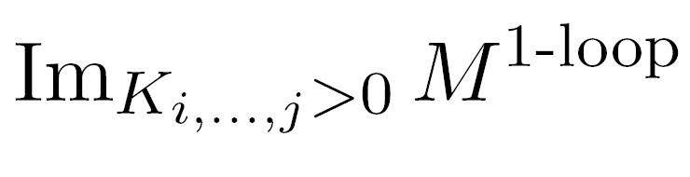

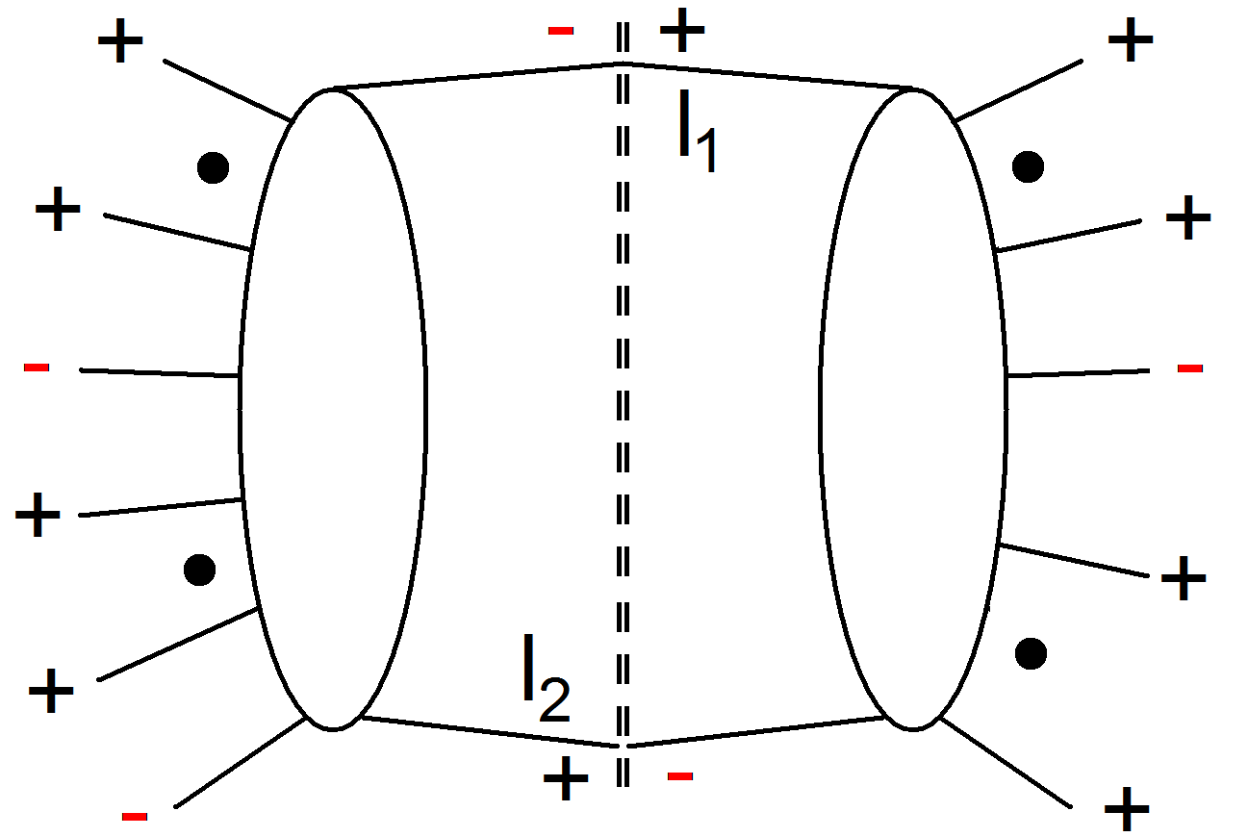
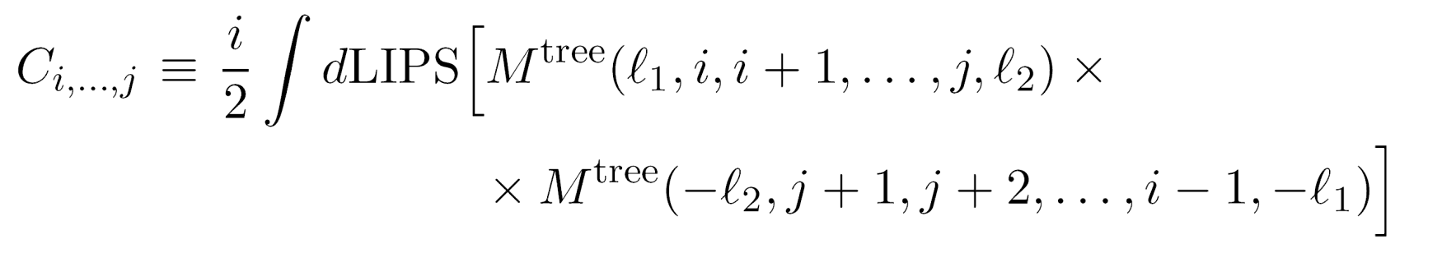
Unitarity cuts
Unitarity methods are building on the cut equation
Singlet
Non-Singlet

Slide 9
Computation of perturbative amplitudes
Complex expressions involving e.g.
(p_{i} • p_{j}) (no manifest symmetry
(p_{i} • ε_{j}) (ε_{I} • ε _{j}) or simplifications)
# Feynman diagrams:
Factorial Growth!
Sum over topological
different diagrams
Generic Feynman amplitude

Slide 10
Amplitudes
Colour ordering
Specifying external
polarisation tensors (ε _{I} • ε _{j})
Symmetry
Simplifications
Tr(T₁ T₂ .. T_{n})
Recursion
Inspiration
from
String theory
Spinor-helicity
formalism
Loop amplitudes:
(Unitarity,
Supersymmetric decomposition)

Slide 11
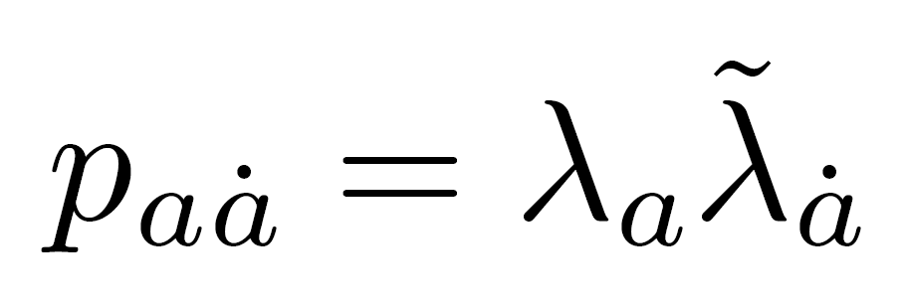
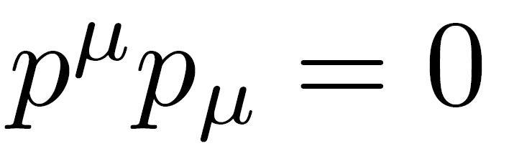
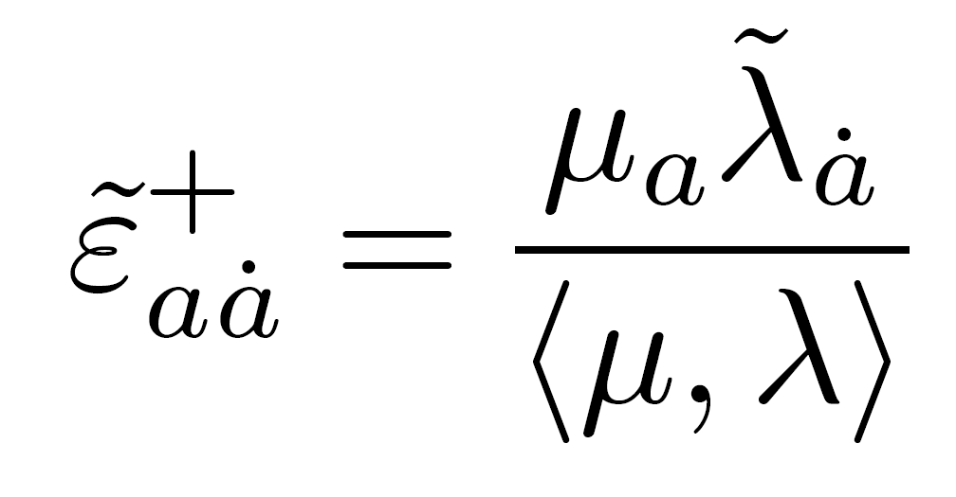
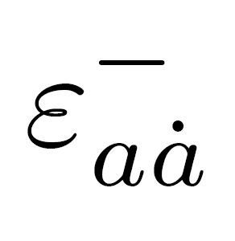

Helicity states formalism
Spinor products :
Different representations of
the Lorentz group
Momentum parts of amplitudes:
Spin-2 polarisation tensors in terms of helicities, (squares of those of YM):
(Xu, Zhang,
Chang)
Notes:
Perhaps include polisation tensor gravity…

Slide 12
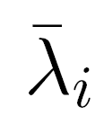
Scattering amplitudes in D=4
Amplitudes in YM theories and gravity theories can hence be expressed via
The external helicies
e.g. : A(1⁺,2⁻,3⁺,4⁺, .. )

Slide 13
MHV Amplitudes

Slide 14
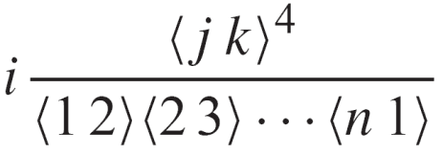
Yang-Mills MHV-amplitudes
(n) same helicities vanishes
A^{tree}(1⁺,2⁺,3⁺,4⁺,..) = 0
(n-1) same helicities vanishes
A^{tree}(1⁺,2⁺,..,j⁻,..) = 0
(n-2) same helicities:
A^{tree}(1⁺,2⁺,..,j⁻,..,k⁻,..) =
Reflection properties: A_{n}(1,2,3,..,n) = (-1)^{n} A_{n}(n,n-1,..,2,1)
Dual Ward: A_{n}(1,2,..,n) + A_{n}(1,3,2,..n)+..+A_{n}(1,perm[2,..n]) = 0
Further identities as we will see….
Tree amplitudes
First non-trivial
example:
One single term!!
Many relations between YM amplitudes, e.g.

Slide 15
Gravity Amplitudes
Expand Einstein-Hilbert Lagrangian :
Features:
Infinitely many vertices
Huge expressions for vertices!
No manifest cancellations nor
simplifications
45 terms + sym
(Sannan)

Slide 16
Simplifications from Spinor-Helicity
Huge simplifications
45 terms + sym
Vanish in spinor helicity formalism
Gravity:
Contractions

Slide 17
String theory

Slide 18

String theory
Different form for amplitude
Feynman diagrams sums separate kinematic poles
String theory adds channels up..
<->
2
1
M
x
3
1
1
x
x
1
2
s₁₂
s_{1M}
s₁₂₃
x
=
+
+
...
.
2
3
M
.

Slide 19

String theory
Notion of color ordering
Color ordered
Feynman rules
1
s₁₂
2
1
x
3
2
x
x
x
.
M
.

Slide 20
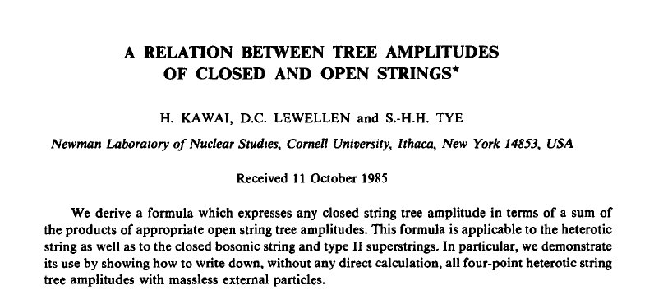
…a more efficient way

Slide 21
Gravity Amplitudes
Not Left-Right symmetric
Closed String
Amplitude
Phase factor
Left-movers
Right-movers
Sum over
permutations
(Kawai-Lewellen-Tye)

Slide 22
Gravity Amplitudes
2
1
M
x
3
1
1
x
x
1
2
s₁₂
s_{1M}
s₁₂₃
x
=
+
+
...
.
2
3
M
.
(Link to individual Feynman diagrams lost..)
Certain vertex
relations possible
Concrete Lagrangian formulation possible?
(Bern and Grant;
Ananth and Theisen;
Hohm)

Slide 23
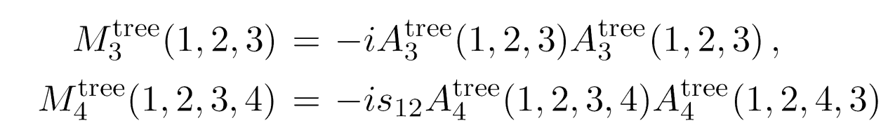
Gravity Amplitudes
KLT explicit representation:
α’ -> 0
e^{iπφ} -> Polynomial (s_{ij})
No manifest
crossing symmetry
(Bern et al)
Higher point expressions quite bulky ..
(2)
Sum gauge invariant
2
(4)
(1)
1
M
1
Double poles
1
x
3
(s₁₂₄)
x
x
1
2
s₁₂
s_{1M}
s₁₂₃
x
=
+
+
...
.
2
3
M
.
(4)
Interesting remark: The KLT relations work independently of external polarisations

Slide 24
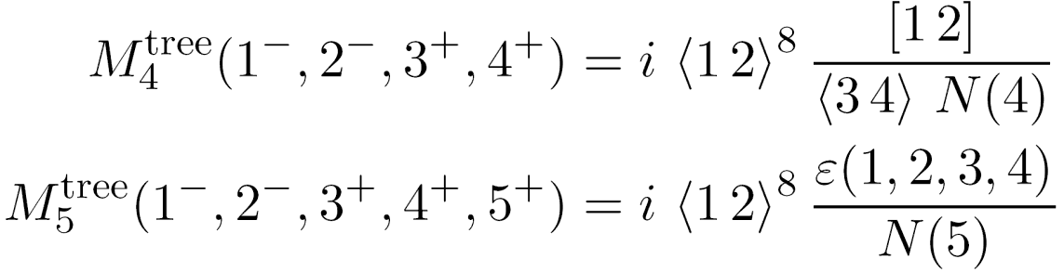
Gravity MHV amplitudes
Can be generated from KLT via YM MHV amplitudes.
(Berends-Giele-Kuijf) recursion formula
Anti holomorphic
Contributions
– feature in gravity

Slide 25
New relations
for Yang-Mills

Slide 26


New relations for amplitudes
Kinematic structure in Yang-Mills:
(Bern, Carrasco, Johansson)
New
Kinematic analogue
– not unique ??
Relations between amplitudes
4pt vertex??
n-pt

Slide 27
New relations for amplitudes
5 points
(n-3)!
Basis where 3 legs are fixed
Nice new way to do gravity
Double-copy gravity from YM!
(Bern, Carrasco, Johansson;
Bern, Dennen, Huang, Kiermeier)

Slide 28
Monodromy

Slide 29
String theory
2
1
M
x
3
1
1
x
x
1
2
s₁₂
s_{1M}
s₁₂₃
x
=
+
+
...
.
2
3
M
.
29

Slide 30


Monodromy relations

Slide 31



Monodromy relations
KK relations
BCJ relations
FT limit-> 0
New relations
(Bern, Carrasco, Johansson)
(NEJBB, Damgaard, Vanhove;
Stieberger)

Slide 32
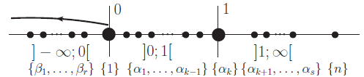
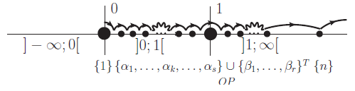
Monodromy relations
(n-2)! functions in basis
(Kleiss – Kuijf) relations
Monodromy related
(n-3)! functions in basis
(BCJ) relations

Slide 33




Monodromy relations
Real part :
Imaginary part :

Slide 34
Gravity

Slide 35


Gravity Amplitudes
Possible to monodromy relations to rearrange KLT

Slide 36
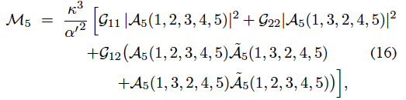
Gravity Amplitudes
More symmetry but can do better…

Slide 37


Monodromy and KLT
Another way to express the BCJ monodromy relations
using a momentum S kernel
Express ‘phase’ difference between orderings in sets

Slide 38


Monodromy and KLT
String Theory also a natural
interpretation via
(NEJBB, Damgaard,
Feng, Sondergaard;
NEJBB, Damgaard,
Sondergaard,Vanhove)
Stringy BCJ monodromy!!

Slide 39

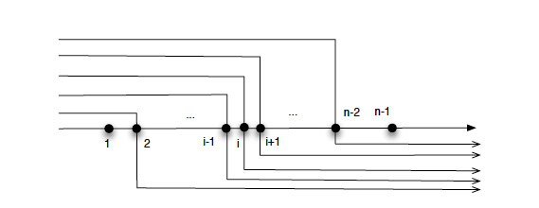
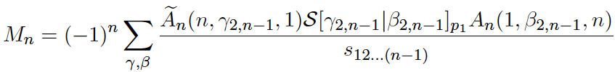
KLT relations
Redoing KLT using S kernels leads to…
Beautifully symmetric form for (j=n-1)
gravity…

Slide 40
Symmetries
String theory may trivialize certain symmetries (example monodromy)
Monodromy relations between different orderings of legs gives reduction of basis of amplitudes
Rich structure for field theories:
Kawai-Lewellen-Tye gravity relations

Slide 41
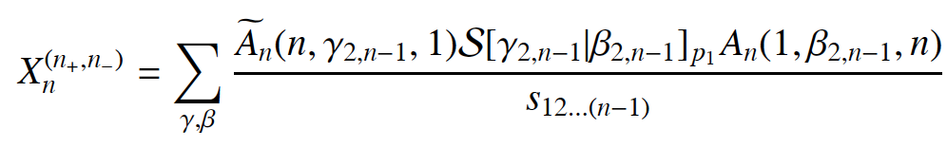


Vanishing relations
Also new ‘vanishing identities’ for YM amplitudes possible
Related to R parity violations
(NEJBB, Damgaard,
Feng, Sondergaard
(Tye and Zhang; Feng and He; Elvang and Kiermeier)
Gives link between amplitudes in YM

Slide 42
Jacobi algebra
relations

Slide 43
Monodromy and Jacobi relations
Kinematic structure in Yang-Mills:
(Bern, Carrasco, Johansson)
New
Monodromy -> (n-3)! reduction <-
Vertex
kinematic structures

Slide 44
Monodromy and Jacobi relations
3pt vertex only… natural in string theory
YM in lightcone gauge (space-cone)
(Chalmers and Siegel, Congemi)
Direct have spinor-helicity formalism for
amplitudes via vertex rules

Slide 45
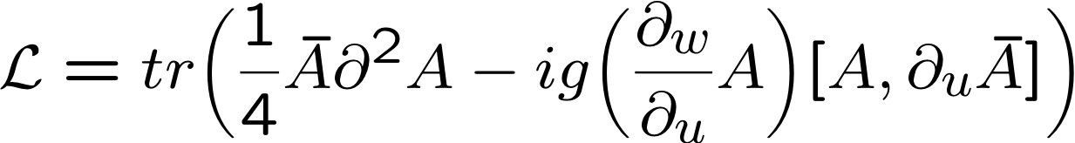
Algebra for amplitudes
Self-dual sector:
Light-cone coordinates:
(Chalmers and Siegel, Congemi, O’Connell and Monteiro)
Gauge-choice + Eq. of motion
Simple vertex rules
(O’Connell and Monteiro)

Slide 46
Algebra for amplitudes
Jacobi-relations

Slide 47
Algebra for amplitudes
vertex
2
s₁₂
s_{1M}
3
s₁₂₃
+
+
...
1
2
Self-dual vertex e.g.

Slide 48
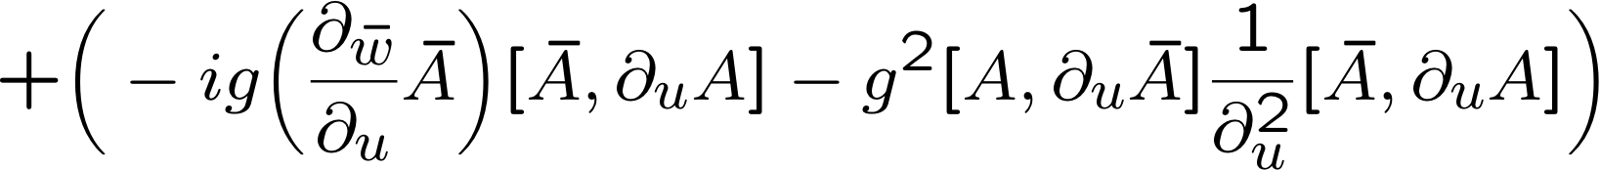
Algebra for amplitudes
self-dual
full action

Slide 49
Algebra for amplitudes
Have to do two algebras, and
Pick reference frame that
makes 4pt vertex -> 0
(O’Connell and Monteiro)

Slide 50
Algebra for amplitudes
MHV case:
Still only cubic vertices – one needed
Jacobi-relations

Slide 51
Algebra for amplitudes
vertex
2
s₁₂
s_{1M}
3
s₁₂₃
+
+
...
1
2
on one reference vertex
MHV vertex as self-dual case… with now
(O’Connell and Monteiro)

Slide 52
Algebra for amplitudes
General case:
Possible to do something similar for general
non-MHV amplitudes??
Problem to make 4pt interaction go away

Slide 53
Algebra for amplitudes
Inspiration from self-dual theories
Work out result for amplitude….
Jacobi works… so ????

Slide 54
Algebra for amplitudes
Try something else…
Pick (n-3)! scalar theories (different Y)
(NEJBB, Damgaard, O’Connell and Monteiro)
YM (colour ordered)
different scalar theories
(n-3)! basis for YM

Slide 55
Algebra for amplitudes
Full amplitude
Now we have (manifest Jacobi YM amplitudes):

Slide 56




Color-dual forms
YM amplitude
YM dual amplitude
(Bern, Dennen)

Slide 57


Relations for loop amplitudes
Jacobi relations for numerators also exist at loop level.. but still an open question to develop
direct vertex formalism (scalar amplitudes??)
Especially in gravity computations – such relations can be crucial testing UV behaviour
(see Berns talk)
Monodromy relations for finite amplitudes (A(++++..++) and A(-+++..++) (NEJBB, Damgaard,
Johansson, Søndergaard)

Slide 58
Conclusions

Slide 59
Conclusions
Much more to learn about amplitude relations…
Presented explicit way of generating
numerator factors satisfying Jacobi.
Useful for better understanding of
Yang-Mills and gravity!
Open question: which Lie algebras are best?

Slide 60
Conclusions
More to learn from String theory??…loop-level?
pure spinor formalism (Mafra, Schlotterer, Stieberger)
Higher derivative operators? (Dixon, Broedel)
Many applications for gravity, N=8, N=4, (double copy)
computations impossible otherwise.
Inspiration from self-dual/MHV –
can we do better?
More investigation needed…

