Slide 1

Maximal Unitarity at Two Loops
David A. Kosower
Institut de Physique Théorique, CEA–Saclay
work with Kasper Larsen & Henrik Johansson; & work of Simon Caron-Huot & Kasper Larsen
1108.1180, 1205.0801, 1208.1754 & in progress
Amplitudes and Periods, IHES
December 3–7, 2012

Slide 2
Amplitudes in Gauge Theories
Amplitudes are the key quantity in perturbative gauge theories
Infrared-divergent but all infrared-safe physical quantities can be built out of them
Recent years have seen lots of excitement in N=4 SUSY
Basic building block for physics predictions in QCD
NLO calculations give the first quantitative predictions for LHC physics, and are essential to controlling backgrounds: require one-loop amplitudes
For some processes (gg → W⁺W⁻, gg → ZZ) two-loop amplitudes are needed
For NNLO & precision physics, we also need to go beyond one loop

Slide 3


Slide 4




On-Shell Methods
Use only information from physical states
Avoid size explosion of intermediate terms due to unphysical states
Use properties of amplitudes as calculational tools
  Factorization → on-shell recursion (Britto, Cachazo, Feng, Witten,…)
  Unitarity → unitarity method (Bern, Dixon, Dunbar, DAK,…)
  Underlying field theory integral basis
Formalism
Known integral basis:
Unitarity
On-shell Recursion;
D-dimensional unitarity
via ∫ mass

Slide 5

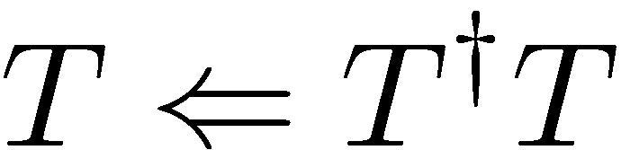
Unitarity
Unitarity of the S matrix tells us that the discontinuity of the transition matrix is expressed in terms of a simpler quantity
Simpler because we get higher loop order from lower loop order; one loop from trees
The on-shell method tells us how to get the full transition matrix back

Slide 6
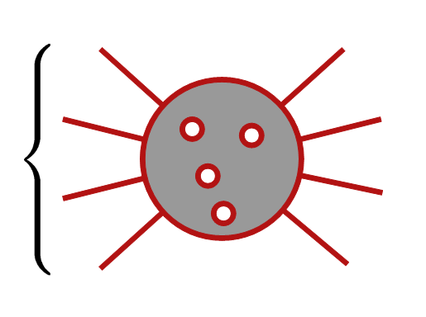
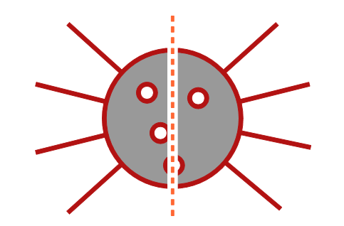
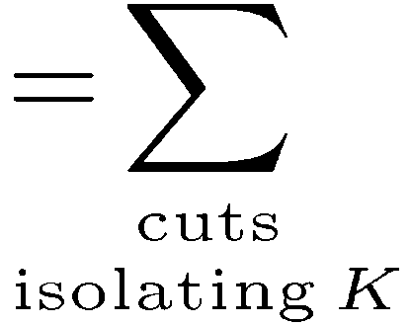


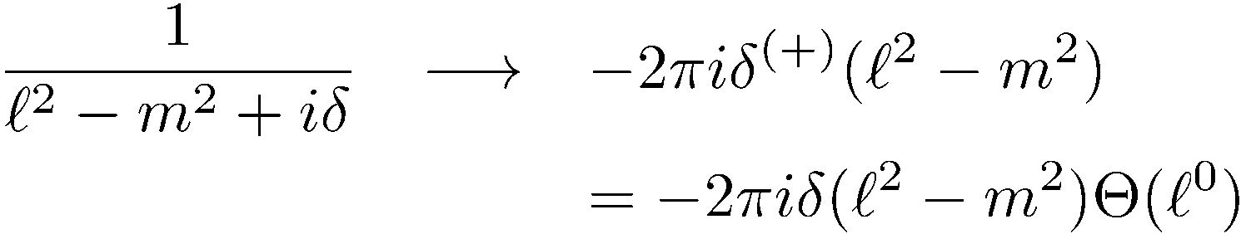
In Feynman Integrals
Cutkosky rules (1960s)
Each cut:

Slide 7



Unitarity-Based Calculations
  Bern, Dixon, Dunbar, & DAK,
  ph/9403226, ph/9409265
Replace two propagators by on-shell delta functions
⇒ Sum of integrals with coefficients; separate them by algebra

Slide 8



Slide 9


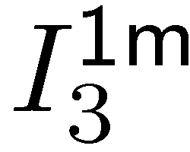
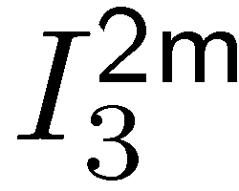


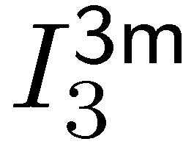
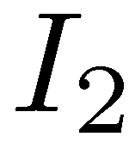

Slide 10
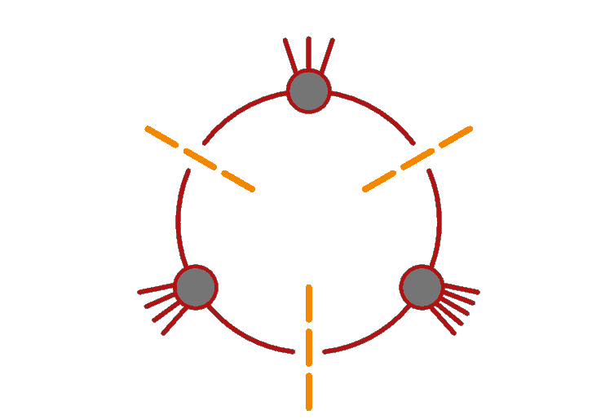
Generalized Unitarity
Journey from a concept natural to physicists but strange to mathematicians — to one natural to mathematicians but strange to physicists
Can we pick out contributions with more than two propagators?
Yes — cut more lines
Isolates smaller set of integrals: only
integrals with propagators corresponding
to cuts will show up
Triple cut — no bubbles, one triangle, smaller set of boxes

Slide 11
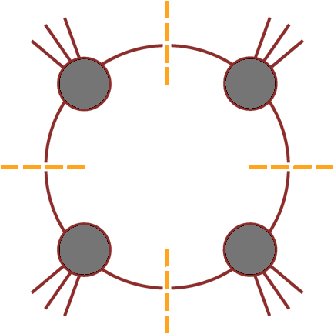
Can we isolate a single integral?
D = 4 → loop momentum has four
components
Cut four specified propagators
(quadruple cut) would isolate a single box

Slide 12
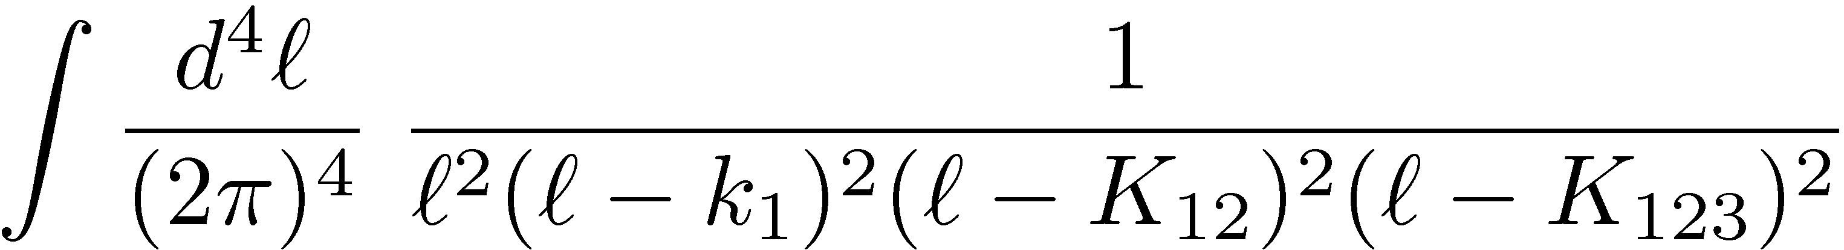
Quadruple Cuts
Work in D=4 for the algebra
Four degrees of freedom & four delta functions
… but are there any solutions?

Slide 13
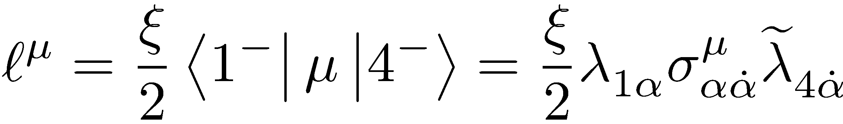
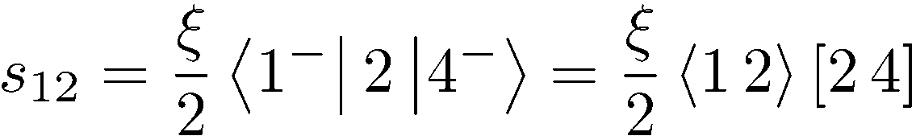
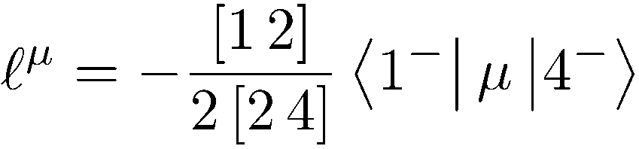
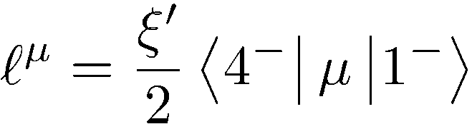
Do Quadruple Cuts Have Solutions?
The delta functions instruct us to solve
1 quadratic, 3 linear equations ⇒ 2 solutions
If k₁ and k₄ are massless, we can write down the solutions explicitly
solves eqs 1,2,4;
Impose 3rd to find
or

Slide 14
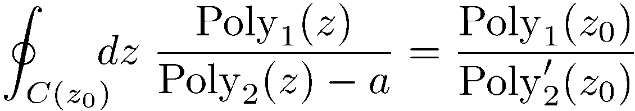

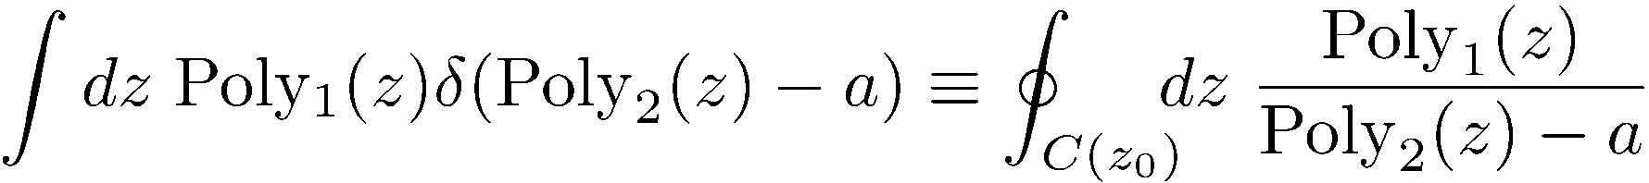
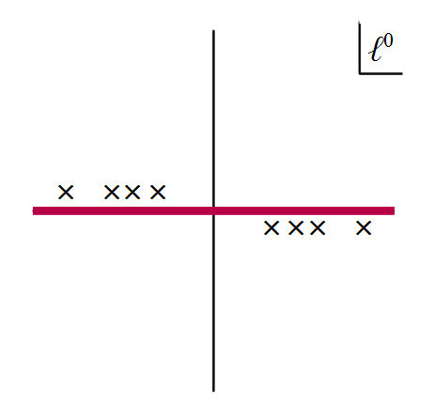
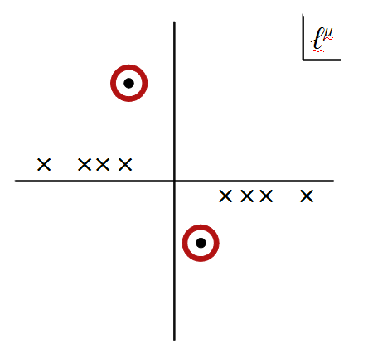
Solutions are complex
The delta functions would actually give zero!
Need to reinterpret delta functions as contour integrals around a global pole
Reinterpret cutting as contour modification

Slide 15

Two Problems
We don’t know how to choose a contour
Changing the contour can break equations:
is no longer true if we deform the real contour to circle one of the poles
Remarkably, these two problems cancel each other out

Slide 16

Require vanishing Feynman integrals to continue vanishing on cuts
General contour
⇒ a₁ = a₂

Slide 17
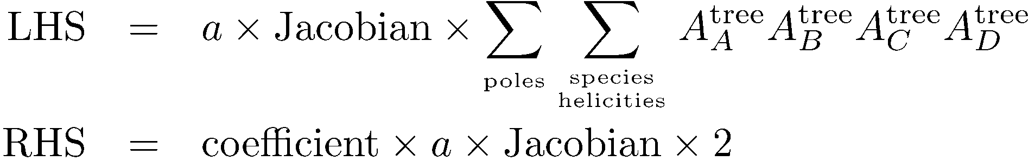
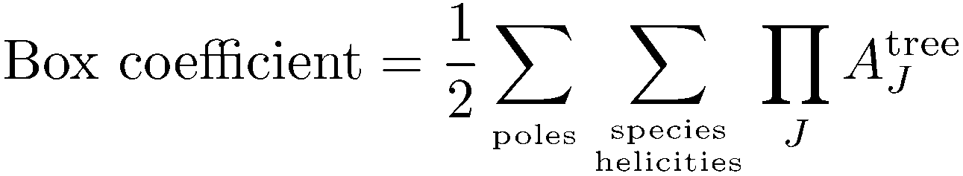
Box Coefficient
A
B
D
C
Go back to master equation
Change to quadruple-cut contour C on both sides
Solve:
No algebraic reductions needed: suitable for pure numerics
Britto, Cachazo & Feng (2004)

Slide 18
Higher Loops
How do we generalize this to higher loops?
  Basis; Generalized Unitarity
Work with dimensionally-regulated integrals
  Ultraviolet regulator
  Infrared regulator
  Means of computing rational terms
  External momenta, polarization vectors, and spinors are strictly four-dimensional
Two kinds of integral bases
  To all orders in ε (“D-dimensional basis”)
  Ignoring terms of O(ε) (“Regulated four-dimensional basis”)

Slide 19
Tools
Tensor reduction: reexpress tensors in terms of differences of denominators
Integration by parts (IBP): reduce powers of irreducible numerators
Gram determinants: eliminate integrals whose only independent terms are of O(ε)

Slide 20
A Physicist’s Adventures in the Land of Algebraic Varieties
We’re interested in the variety given by
because in a certain sense, the integral’s coefficient is there
S. Caron-Huot’s talk told us that in a certain sense, the expression for the integral itself is there too
It turns out that the knowledge of the basis is there as well

Slide 21
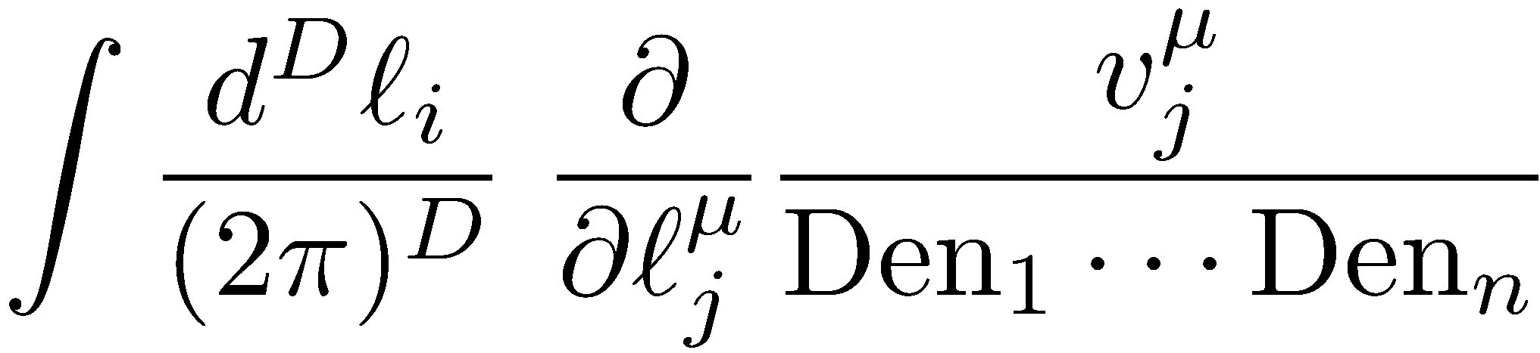
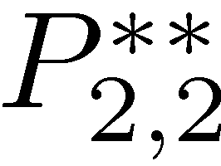
IBP-Generating Vectors
Find vectors that generate IBP relations
manifestly free of doubled propagators
Double box

Slide 22


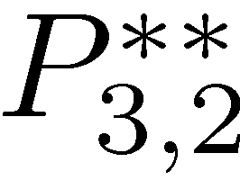
Examples
Massless, one-mass, diagonal two-mass, long-side two-mass double boxes : two integrals
Short-side two-mass, three-mass double
boxes: three integrals
Four-mass double box: four integrals
Massless pentabox : three integrals
All integrals with n₂ ≤ n₁ ≤ 4, that is with up to 11 propagators
⇒ This is the D-dimensional basis

Slide 23



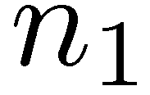
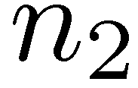
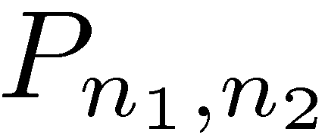
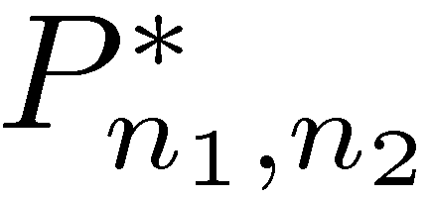
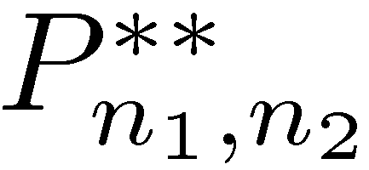


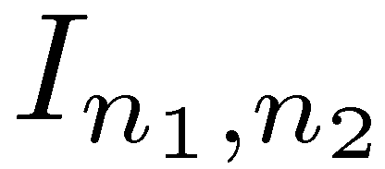
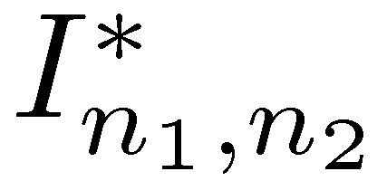
Planar Two-Loop Integrals
Massless internal lines; massless or massive external lines

Slide 24
Four-Dimensional Basis
If we drop terms which are ultimately of O(ε) in amplitudes, we can eliminate all integrals beyond the pentabox , that is all integrals with more than eight propagators

Slide 25

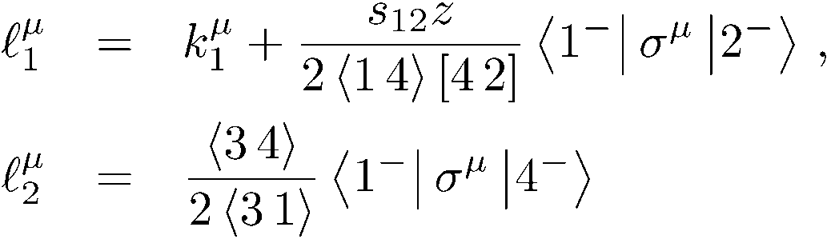
Massless Planar Double Box
[Generalization of OPP: Ossola & Mastrolia & Mirabella, Peraro (2011–2); Badger, Frellesvig, & Zhang (2012); Kleiss, Malamos, Papadopoulos & Verheyen (2012)]
Here, generalize work of Britto, Cachazo & Feng, and Forde
Take a heptacut — freeze seven of eight degrees of freedom
One remaining integration variable z
Six solutions, for example

Slide 26
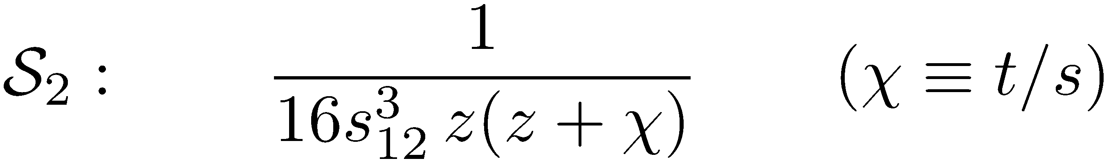
Need to choose contour for z within each solution
Jacobian from other degrees of freedom has poles in z: naively, 14 solutions aka candidate global poles
Note that the Jacobian from contour integration is 1/J, not 1/|J|
Different from leading singularities
Cachazo & Buchbinder (2005)

Slide 27
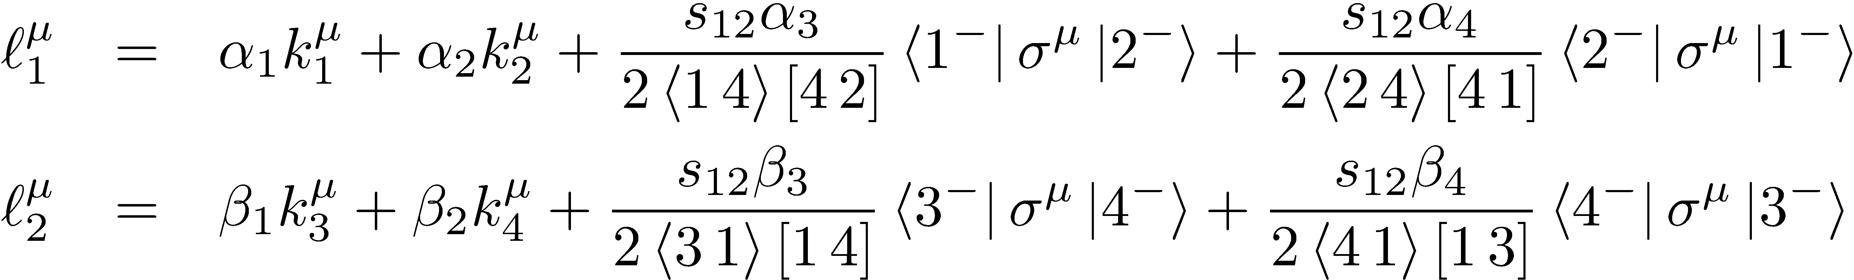
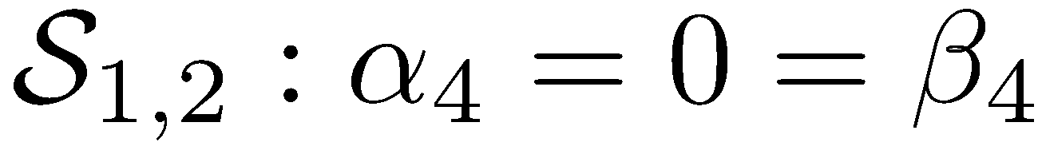
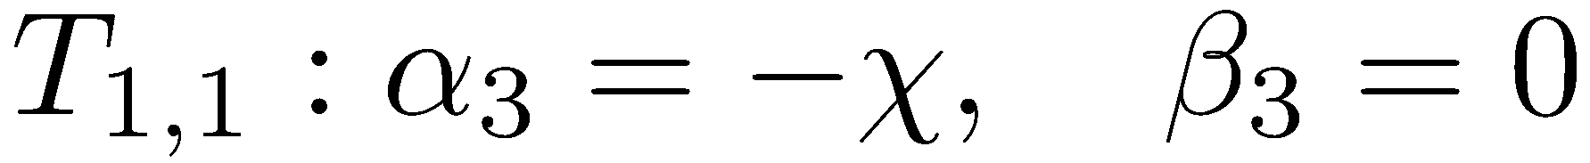
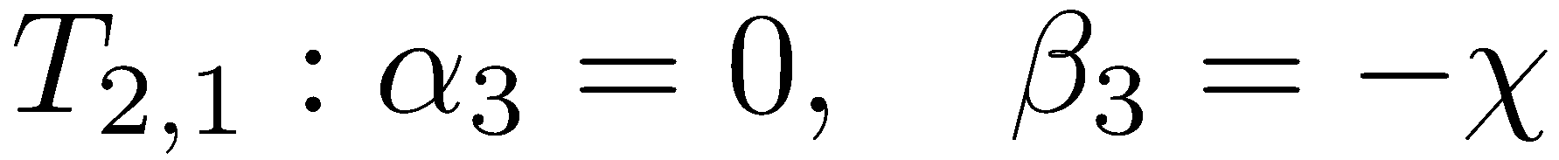
How Many Solutions Do We Really Have?
Caron-Huot & Larsen (2012)
Parametrization
All heptacut solutions have
Here, naively two global poles each at z = 0, −χ
Overall, we are left with 8 distinct global poles
same!

Slide 28
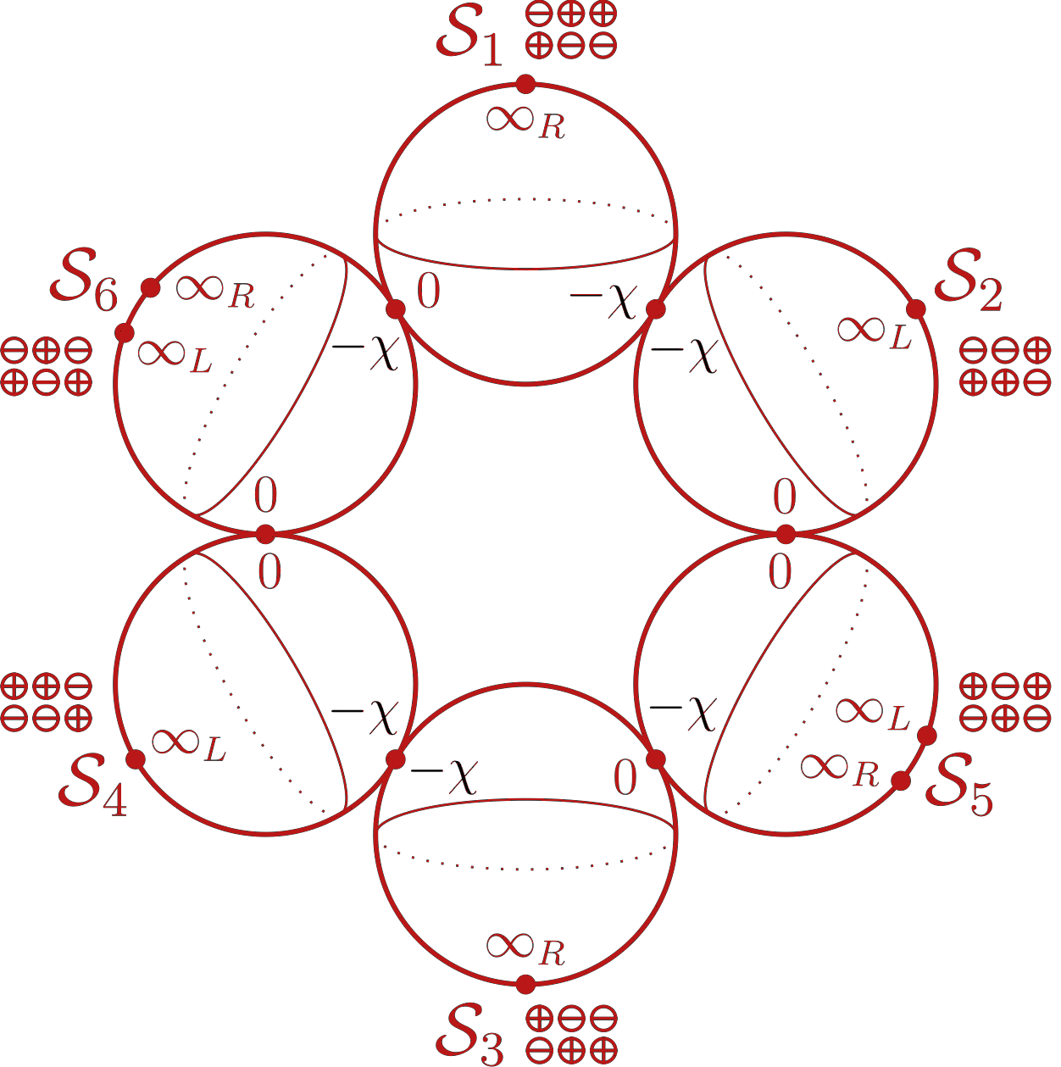

Slide 29
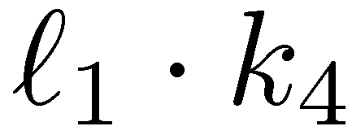
Two basis or ‘master’ integrals: I₄[1] and I₄[ℓ₁∙k₄]
Want their coefficients

Slide 30
Picking Contours
A priori, we can deform the integration contour to any linear combination of the 8; which one should we pick?
Need to enforce vanishing of all total derivatives:
  5 insertions of ε tensors
  ⇒ 4 independent constraints
  20 insertions of IBP equations
  ⇒ 2 additional independent constraints
Seek two independent “projectors”, giving formulæ for the coefficients of each master integral
  In each projector, require that other basis integral vanish
  Work to O(ε⁰); higher order terms in general require going beyond four-dimensional cuts

Slide 31
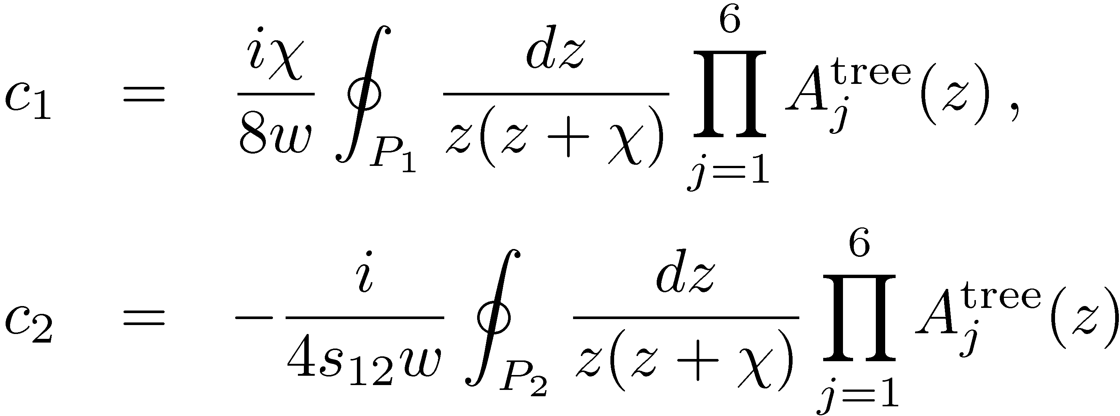
Master formulæ for basis integrals
To O (ε⁰); higher order terms require going beyond four-dimensional cuts

Slide 32
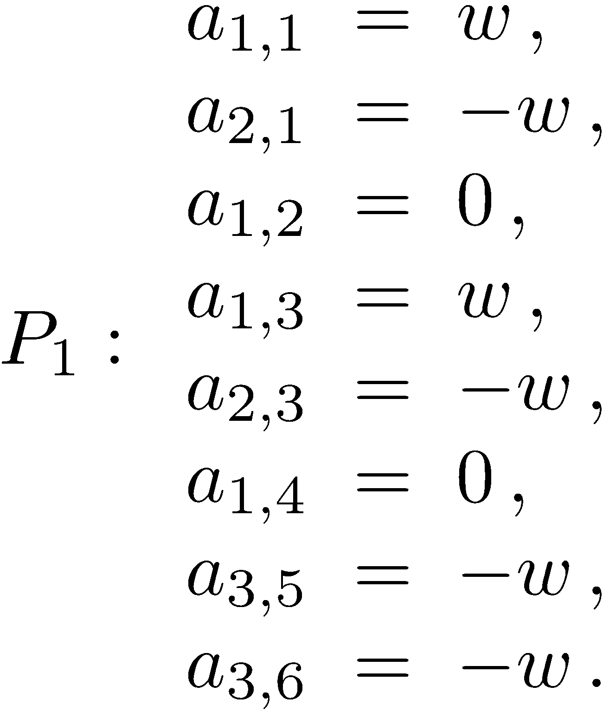
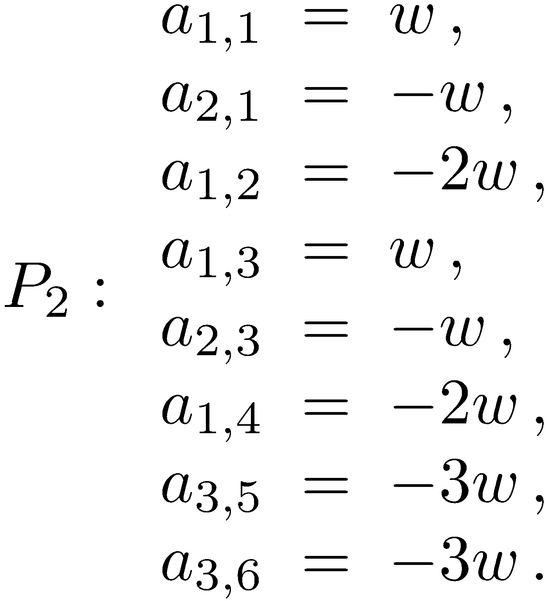
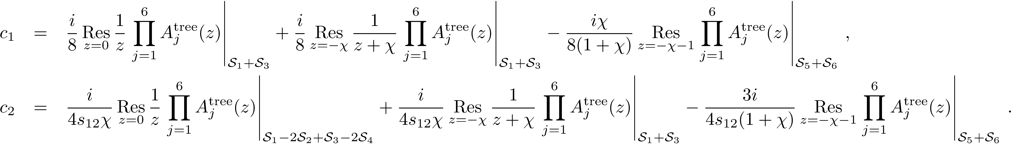
Contours
Up to an irrelevant overall normalization, the projectors are unique, just as at one loop
More explicitly,

Slide 33
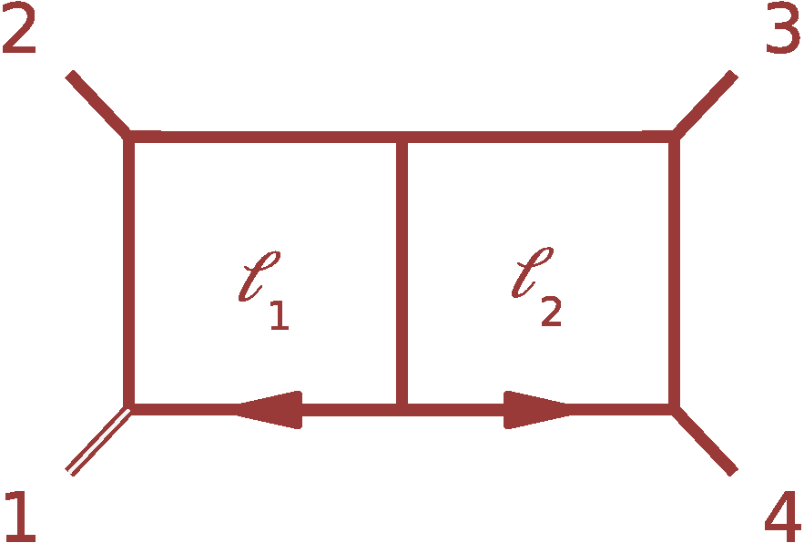
One-Mass & Some Two-Mass Double Boxes
Take leg 1 massive;
legs 1 & 3 massive;
legs 1 & 4 massive
Again, two master integrals
Choose same numerators as for massless double box:
1 and
Structure of heptacuts similar
Again 8 true global poles
6 constraint equations from ε tensors and IBP relations
Unique projectors — same coefficients as for massless DB (one-mass or diagonal two-mass), shifted for long-side two-mass

Slide 34
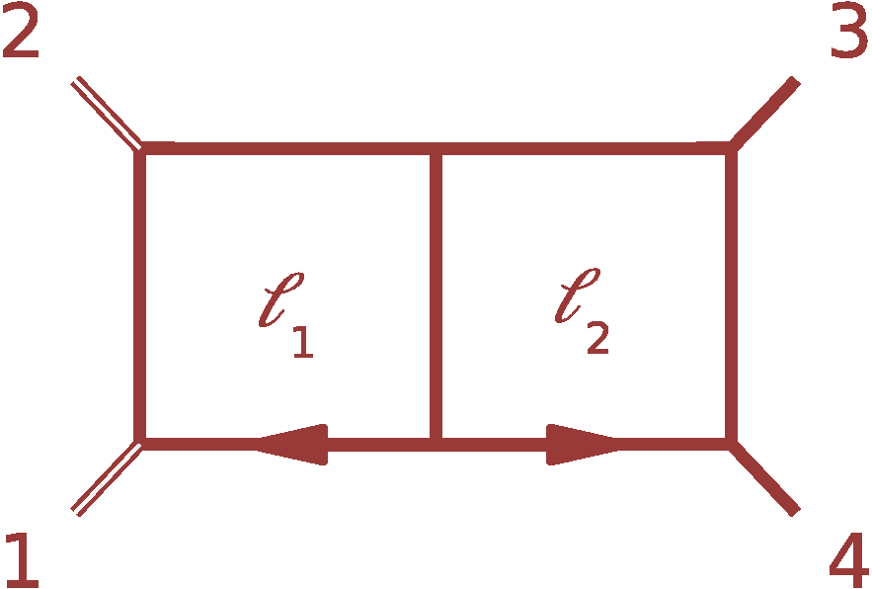
Short-side Two-Mass Double Box
Take legs 1 & 2 to be massive
Three master integrals:
I₄[1], I₄[ℓ₁∙k₄] and I₄[ℓ₂∙k₁]
Structure of heptacut equations is different: 12 naïve poles
…again 8 global poles
Only 5 constraint equations
Three independent projectors
Projectors again unique (but different from massless or one-mass case)

Slide 35
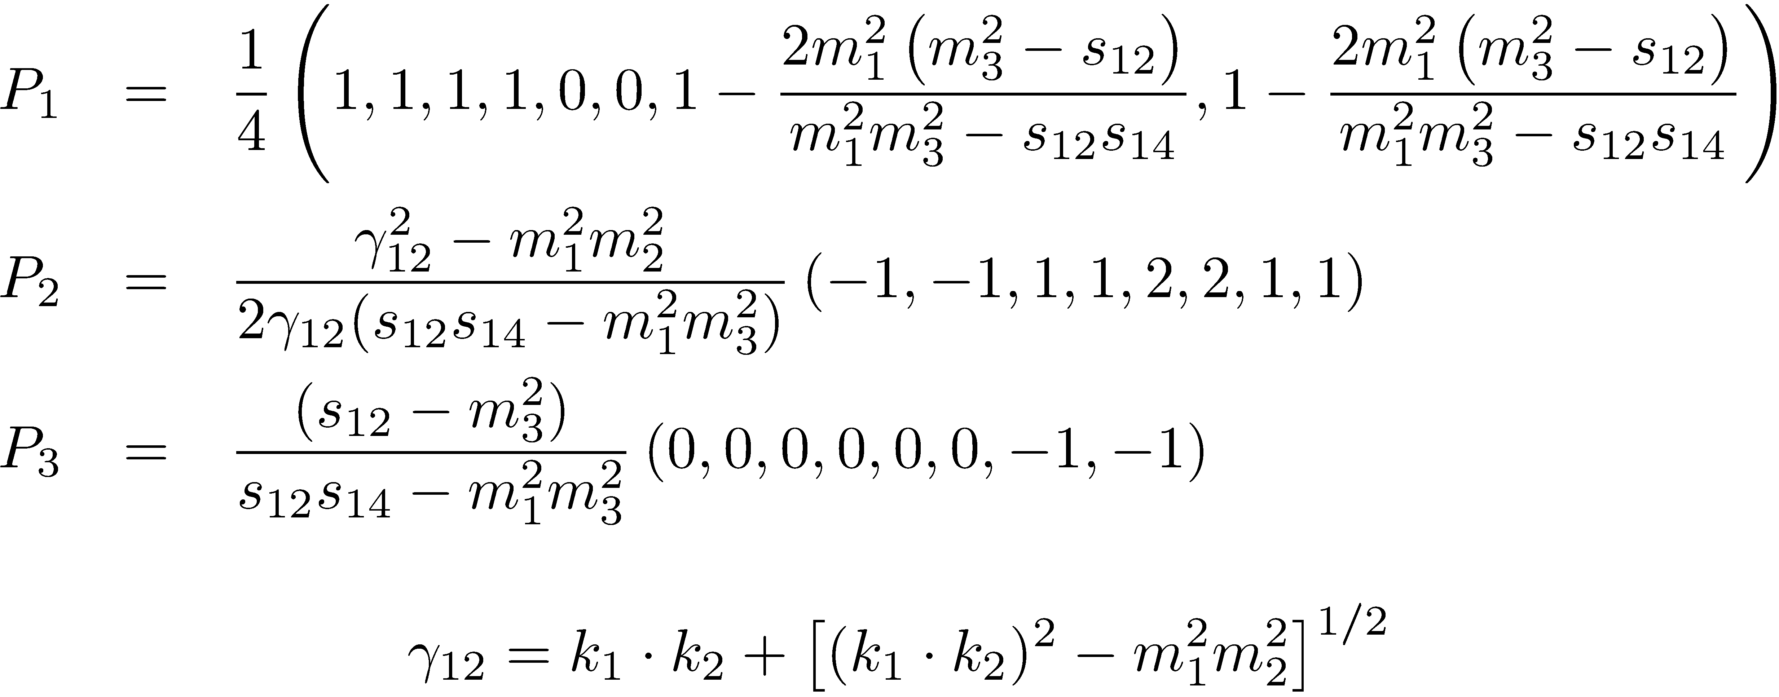
Short-Side Projectors

Slide 36
Massive Double Boxes
Massive legs: 1; 1 & 3; 1 & 4
Master Integrals: 2
Global Poles: 8
Constraints: 2 (IBP) + 4 (ε tensors) = 6
Unique projectors: 2
Massive legs: 1 & 3; 1, 2 & 3
Master Integrals: 3
Global Poles: 8
Constraints: 1 (IBP) + 4 (ε tensors) = 5
Unique projectors: 3
Massive legs: all
Master Integrals: 4
Global Poles: 8
Constraints: 0 (IBP) + 4 (ε tensors) = 4
Unique projectors: 4

Slide 37
Summary
First steps towards a numerical unitarity formalism at two loops
Knowledge of an independent integral basis
Criterion for constructing explicit formulæ for coefficients of basis integrals
Four-point examples: massless, one-mass, two-mass double boxes

